Slide 1
Chapter 11
ONE-WAY BETWEEN-GROUPS ANOVA

Slide 2
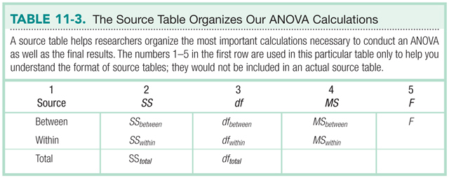
The Source Table

Slide 3
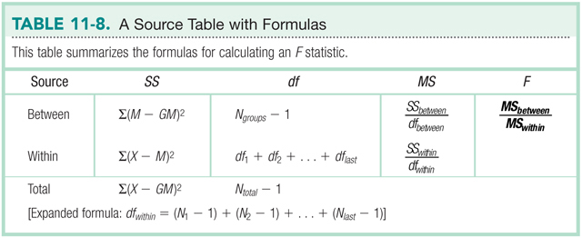
The Source Table

Slide 4
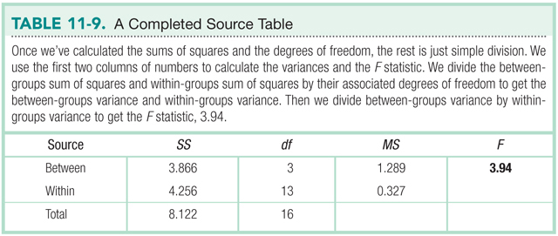
Example
60.68
2
30.34
11.28
24.22
9
2.69
84.96
11

Slide 5
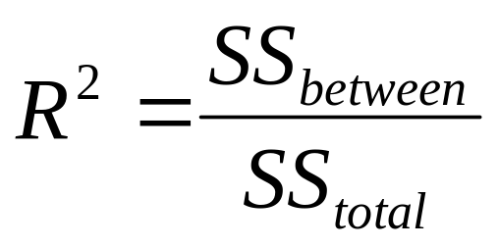
Effect Size
R²
Proportion of variance in the DV that is accounted for by the IV

Slide 6
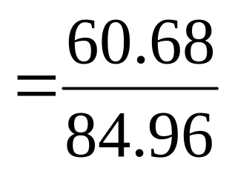
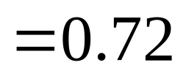
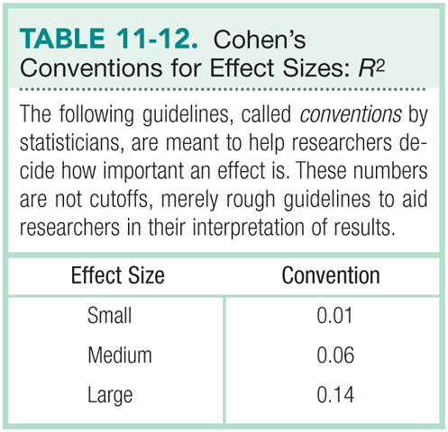
Example

Slide 7
Effect Size
R²
Proportion of variance in the DV that is accounted for by the IV
72% of the variability in pain tolerance is due to the type of drug administered

Slide 8
Multiple-Comparison Tests
When you calculate a significant F, how do you know where the differences are?
2 types of multiple-comparison tests
  a priori
  post-hoc

Slide 9
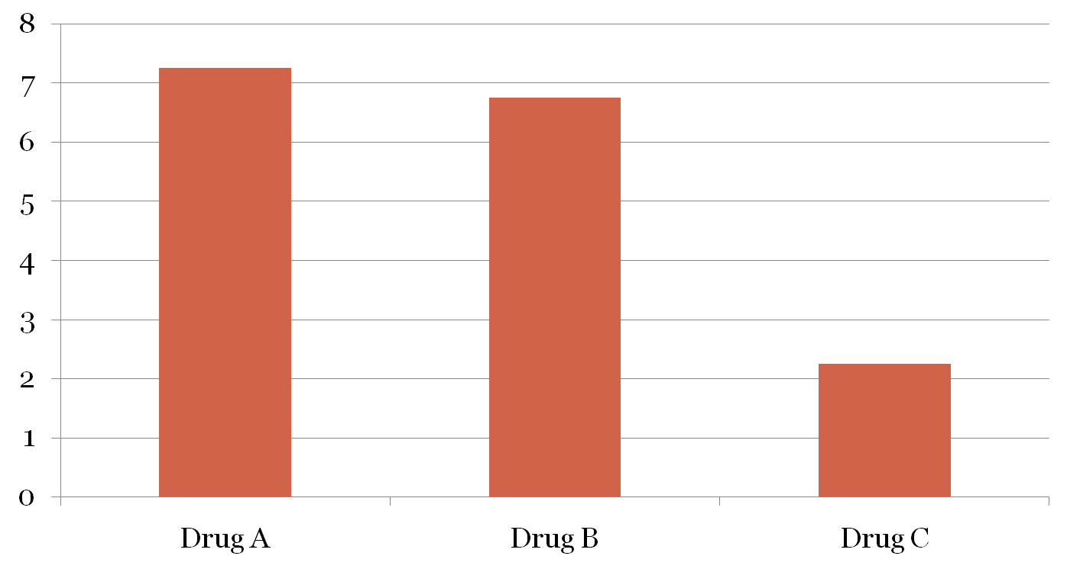
Multiple-Comparison Tests

Slide 10
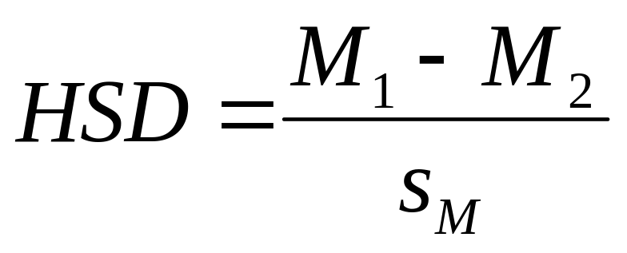
Tukey HSD
variant of t test
adjusted for multiple comparisons

Slide 11
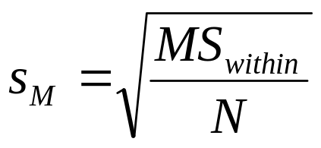

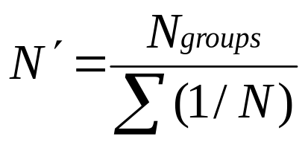
Calculating s_{M} for Tukey HSD
When N is same for all groups,
When samples are different sizes,

